Slide 1
Tasite – 25 YEARS
Janine Bowes
Ken Price
Past Tasite presidents

Slide 2
History
Originally CESIGT – Computer Education Special Interest Group Tasmania
Special Interest Group of ACS Tasmania
Financial accounts etc. managed through ACS Tasmania
jb

Slide 3
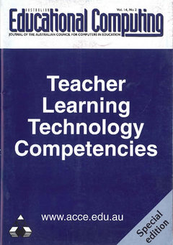
AEC Journal 1999
Teacher Learning Technology Competencies – lead writing
jb

Slide 4
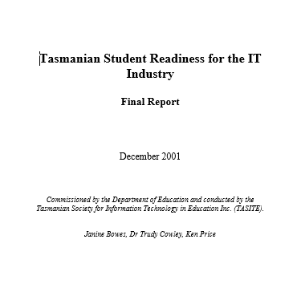
Student REadiness
INDUSTRY REPORT Commissioned by DoE Tasmania
2001
jb

Slide 5
National Conference held by TASITE in Hobart, 2002
jb

Slide 6
First Australian
SMS Poetry Competition
2003
kp

Slide 7
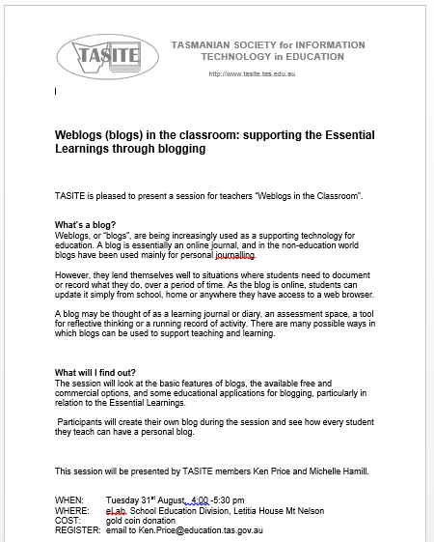
Blogs and Blogging
2004
kp

Slide 8
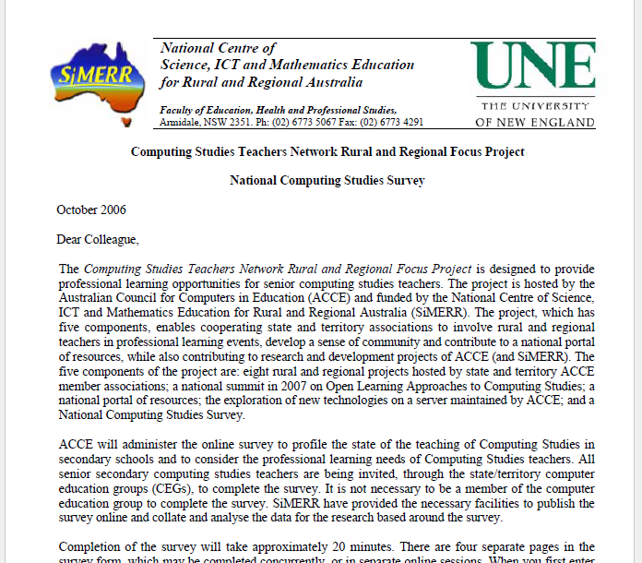
National computing Studies Teacher survey
2006
kp

Slide 9
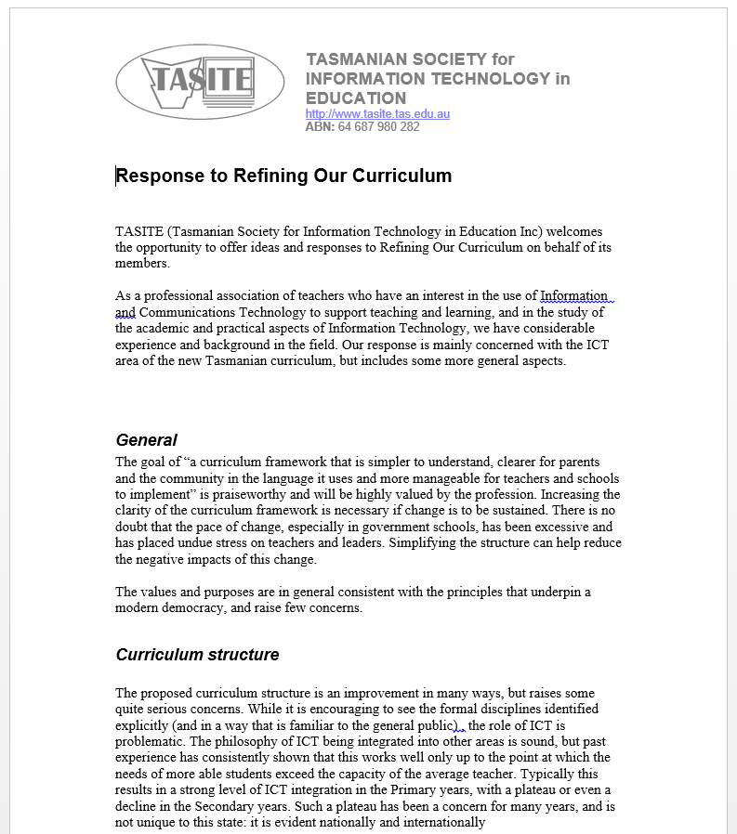
Refining our curriculum
2006
kp

Slide 10
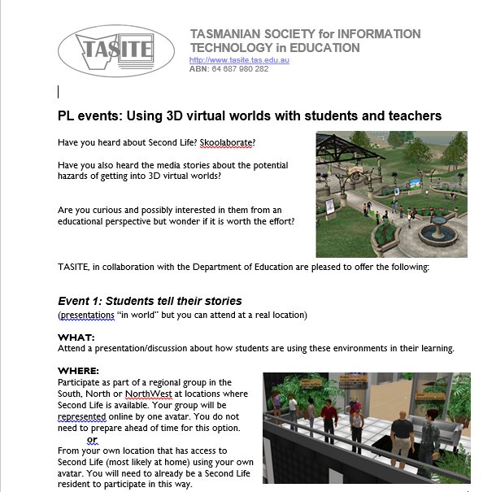
3D worlds
Possibly the first PL in this topic in Australian education
2007
jb

Slide 11
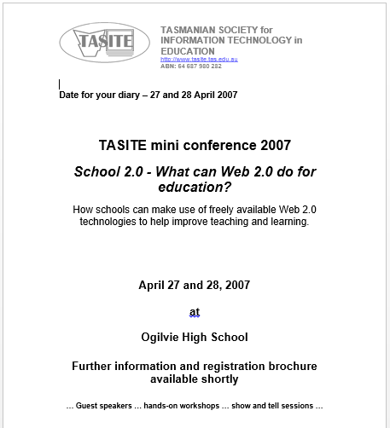
Web 2.0 conference
2007
jb

Slide 12
Scootle
2011
kp

Slide 13
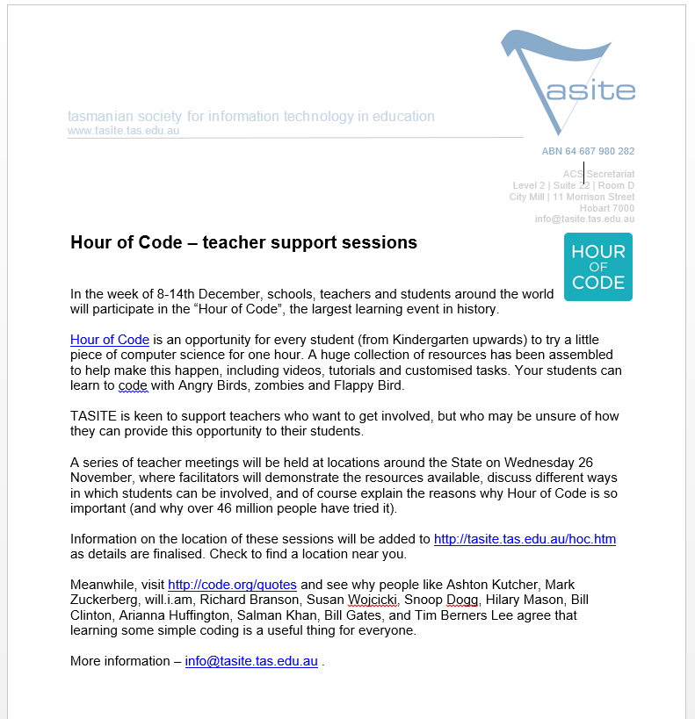
Hour of Code
kp

Slide 14
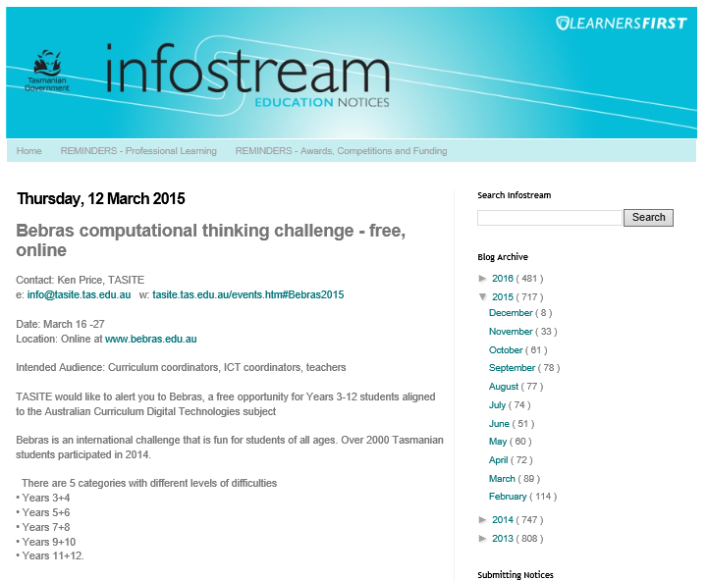
BEBRAS
Highest per capita participation nationally
kp

Slide 15
Helped professional organisations move online via NEAT (Network of Educational Associations Tasmania)
jb

Slide 16
TAS-IT online community – pre-2000 (anyone remember eGroups?)
jb

Slide 17
TASITE PAST events
24 June 2016 Young ICT Explorers - project submissions close
8 and 9 June 2016 Teacher PD: Teachers, technology and the law
6 June (NorthWest), 7 June (North), 8 June (South) Digital Technologies Leadership Forum with Tim Bell
6 June (NorthWest), 7 June (North), 8 June (South) Digital Technologies Workshops with Tim Bell
June through August 2016 Digital Technologies curriculum professional learning
10 June, 2016 - 28 June, 2016 2016 ACCE US Study Tour (inc ISTE conference)
31 May 2016 Young ICT Explorers - registration closes
26 May 2016 Google Educator Certification Bootcamp - Deloraine
25 and 16 May 2016 Teacher PD: Digital rights and digital wrongs
26 May 2016 ACS event - IT in the Pub
10 and 11 May 2016 Teacher PD: Tour of the eSafety website
31 March 2016 ACS EdXN: INNOVATING INNOVATIONS: Creating the Next Generations of Empowerment
30 March 2016 Google Educator Certification Bootcamp - Hobart
14-25 March 2016 Bebras computational thinking competition.
15 March 2016 TASICT event - Harper Reed (student presentation and evening session)
16, 23 and 30 January 2016 Robotics Workshops
07 Dec 2015 - 25 Jan 2016 Google Code-in
07-13 December 2015 Hour of Code 2015 - be part of the biggest event in education history
02 December 2015 Year 11/12 Curriculum information session
27 November 2015 Hour of Code intro session
during 2016 Embedded Systems Learning Program for Digital Technologies
25 Nov, 01 December, 03 December 2015 Google/Utas CS4HS Robotics Workshop (Hobart, Launceston, Cradle Coast)
04 November - 09 December Minecraft at the Battery Shed (Launceston)
15 October 2015 Google Computational Thinking course
7-8 September 2015 Bebras computational thinking challenge
22 August 2015 (judging) Young ICT Explorers competition
17 August 2015 STE(A)M Conference Hobart
June, August 2015 tba CodeClub teacher training
April 2015 MOOC - Think. Create. Code. Learn to code through the creation of artistic images and animation
1 May 2015 MOOC - Digital Technologies for Secondary Teachers (Years 7 and 8)
7-8 July 2015 Slide2Learn conference for users of iOS devices
13 April 2015 MOOC - Robotic Vision
16-27 March 2015 Bebras computational thinking challenge (March)
14 March 2015 DLTV Conference Geelong - SC101 Digitech by the Bay. Engaging Learners through Innovative Teaching
10 March 2015 ACS - EdXN: Risk Management for Big Data Projects
6 March 2015 International Womens Day Cocktail Event.
24 February 2015 Edumate demonstration
20 February 2015 Survey - Year 11 and 12 curriculum (via NEAT)
15 February 2015 MOOC - Introduction to Robotics
February 2015 Apple Distinguished Educator Awards open for applications
8-14 December 2014 Hour of Code - every student should have some experience of writing a simple computer program.
TBA 2015 MOOC - Digital Technologies for Secondary teachers
December 2014 MOOC - Digital Technologies for Primary teachers
Wed 26 November 2014 Hour of Code - teacher sessions.
Thu/Fri 13 and 14 Nov 2014 iOS-8 Developer Workshops (ACS and Secret Lab collaboration)
Thu 30 Oct 2014 EdXN - Disruptive Technologies and Change
Fri 17 Oct 2014 Burger Thing: Introduction to iOS Development
Mon 01 Sep 2014 (recorded webinar) ACCELN Webinar - Seymour Papert, father of educational technology
Mon 25 Aug 2014 (recorded webinar) ACCELN Webinar - Google Classroom
Mon 18 Aug 2014 (recorded webinar) ACCELN Webinar -Wearable Devices
Mon 01 - 15 September 2014 Bebras - Computational Thinking puzzle competition, Years 3-12
Thur 21 August 2014 NEAT session - using social and mobile media to engage with school communities
Mon 04 August - Sunday 7 September NCSS Programming Challenge
Mon 28 July - 22 Sept 2014 Learning to Teach Online - MOOC from UNSW (via Coursera)
recorded webinar ACCELN Webinar - Resources for Digital Technologies from DLTV
recorded webinar ACCELN Webinar - Computational Thinking
recorded webinar ACCELN Webinar - Peer-based learning tools
recorded webinar ACCELN Webinar - the NMC Horizon Report.
30 June - 11 Aug 2014 Assessment and Teaching of 21st Century Skills - MOOC from University of Melbourne. (in Coursera)
1 July (South) and 3 July (North) 2014 The Australian Curriculum A Day with Dr Tim Bell and Dr Katrina Falkner - For Primary Schools
(organised by the Catholic Education Office)
Tue 24 June 2014 CSIRO "ICT In Schools partnership program" Tasmania Technology Forum
Mon 23 June 2014 TASITE AGM
Tue 20 May 2014 ACS event - "The Role Of Technology in Tasmania's Future" a blueprint for Tasmania!
Mon 19 May 2014 Google Experience Day
Wed 02 July 2014 Digital Technologies And The Australian Curriculum: A Day With Dr Tim Bell and Dr Katrina Falkner (organised by the Catholic Education Office)
Thu 08 May 2014 ACS TAS Forum - "The Square Kilometre Array"
From March 2014, online Free online course - Digital Technologies: Implementing the Australian Curriculum Learning Area
18 March 2014 Australian Curriculum - Digital Technologies Workshop (NOTE: this session is organised by AIST)
20 February 2014 Robotics in Education Workshop followed by Extreme EV3 Hack Party
Google Educator Workshops - Hobart., Deloraine
9-15 December 2013 Hour of Code (Computer Science Education Week)
Thu 28 November 2013 EV3 Robotics Workshops Cradle Coast (sponsored by Google Australia)
Tue 26 November 2013 EV3 Robotics Workshops Launceston (sponsored by Google Australia)
Tue 26 November 2013 Improve Formative Assessment Tool (Launceston)
Mon 25 November 2013 Improve Formative Assessment Tool (Burnie)
Wed 20 November 2013 EV3 Robotics Workshops Hobart (sponsored by Google Australia)
Mon 26 October 2013 ACCELN Webinar - "ACCE Study Tours - Learning Unleashes your mind"
Thursday 31 October, 2013 Raspberry Pi Professional Learning Day
Mon 17 October, 2013 ACCELN Webinar - "Space Radio Pioneer"
Mon 10 October 2013 ACCELN Webinar - "Unleash Kids"
Mon 3 October 2013 ACCELN
Mon 16 September 2013 ACCELN Webinar - "Standing Together"
Mon 9 September 2013 ACCELN Webinar -"Dig Your Own Learning"
Mon 2 September 2013 ACCELN Webinar - "Students as Digital Leaders"
Tue 27th August, 2013 Raspberry Pi Workshop (Hobart)
Wed 21st August, 2013 Raspberry Pi Workshop (Devonport)
Wed 14th August, 2013 Raspberry Pi Workshop (Launceston)
Monday July 22 2013 Australian Curriculum Technologies professional learniing day
Friday 14 June 2013 3D Printer Demonstration - Wynyard
Thursday 13 June 2013 Webinar - teaching the 5 Ps of Digital Ethics
Thursday 23May 2013 Google in Education Workshop hosted by The Hutchins School and The Collegiate Institute.
NOTE: this is not a TASITE event but is of relevance to members.
Friday 17 May 2013 3D Printer Demonstration - Hobart
Tuesday 30 April 2013 Scratch Workshop
Wednesday April 17 2013 ACARA Technologies Curriculum - consultation and feedback for Digital Technologies strand and subject F-10
Monday April 16 2013 Primary teachers and Australian Curriculum Digital Technologies: ACCE_LN Google Hangout
Thursday March 14 2013 TASITE AGM
Tues March 12 2013 Apple Learning Tour
Thursday 18 October 2012 BYOD strategies
Thurs 11 October 2012 TeachMeet - free software
Thursday May 3- Sat May 5 2012 iPad/Iphone programming course (provided by ACS Tasmania and SecretLab)
NOTE - one school student has been funded by TASITE to attend this course
Thursday 17 May 2012 TASITE AGM 2012 (5:30pm)
Thursday 17 May 2012 TeachMeet session (6:00pm)
Wednesday May 18 TASITE Annual General Meeting
July 15-17 AADES conference
Wednesday Aug 17 eBooks for Teaching and Learning: A shared perspective.
Wednesday Oct 5 Scootle (Hobart)
Wednesday Oct 12 Scootle (Launceston)
Wednesday Oct 12 Scootle (Smithton)
Tuesday Oct 18 Scootle (King Island)
Wednesday Oct 26 Scootle (Burnie)
Thursday Oct 27 Scootle (Devonport)
Thursday 24th November Calculus in Primary Schools (Launceston)
Thursday Feb 18 Stop Motion Animation
Thursday Feb 25 Video for Beginners
Thursday Mar 4 Mobile Devices to Connect the Classroom to Home
Wednesday Mar 10 Google SketchUp for beginners – Maths focus
Wednesday Mar 17 Google SketchUp for beginners – Designing in 3D
Thursday Apr 15 and Apr 22 Scratch
Wednesday May 5 Google Docs& other collaboration tools
Thursday May 20 and May 27 GameMaker
Wednesday 28 April Annual General Meeting
Monday 19th April 2010 (Launceston)
Thursday 13th May (Hobart) eExaminations
Thursday 20th May (Launceston) World Education Forum Tasmania
10/11/12 May (Hobart) iPhone programming course (ACS event, discount for TASITE members)
16 July ICT Education Walk: Sponsor-ed websites - Ogilivie High School's experiences
Wed 11 August 2010 Comparisons, Confluence and Clouds: the ACCE Study Tour and ISTE 2010 Conference
Wed 25 August 2010 Introducing ThinkQuest
jb

Slide 18
jb

Slide 19
http://tasite.tas.edu.au

